Slide 1

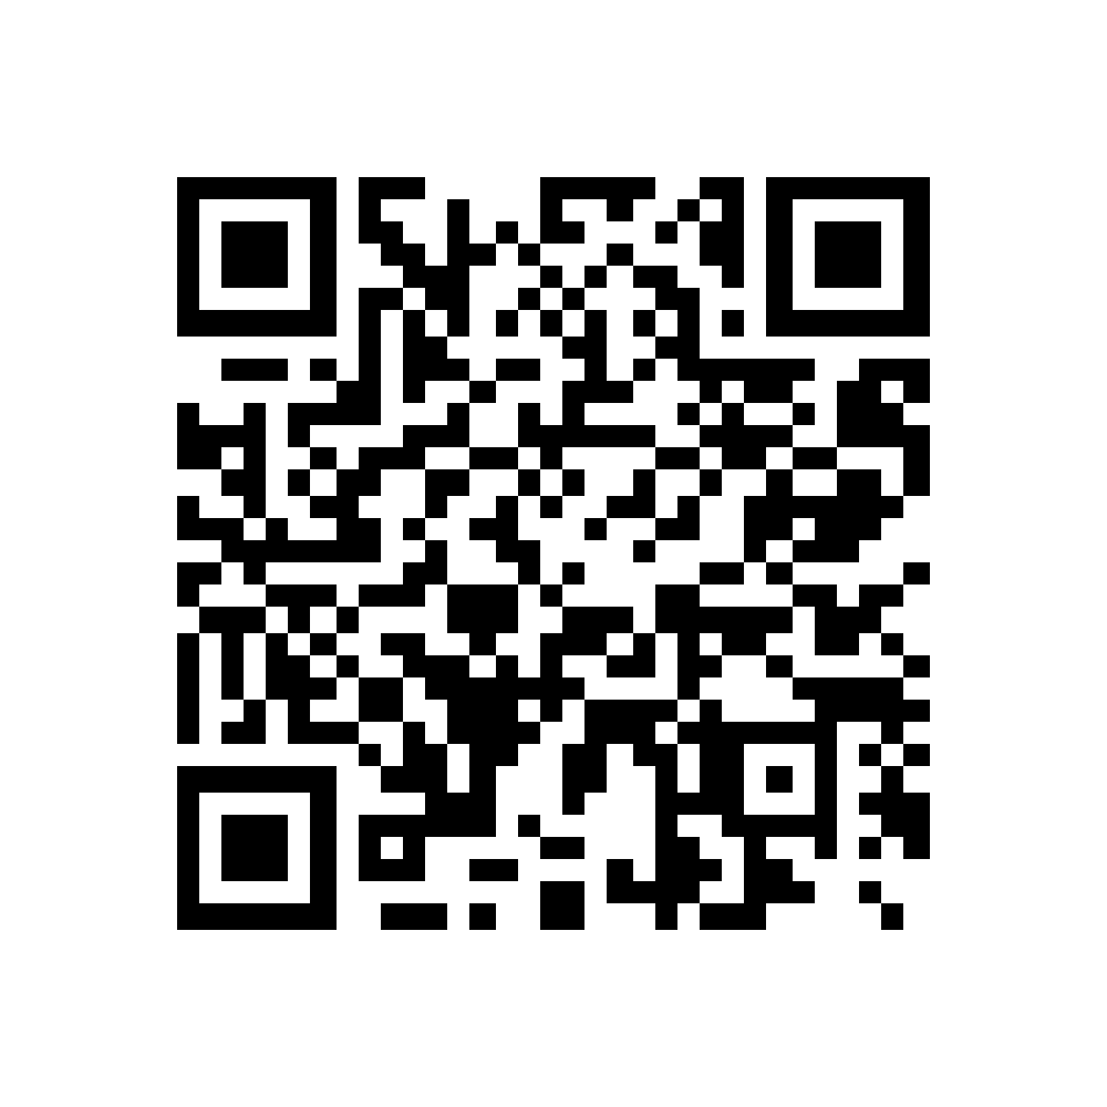
INSY7315 | WORK INTEGRATED LEARNING | EXPO 2026
Kinsmen Barbershop
One connected place to book a chair, manage a barbershop and reserve products.
Scan to open the live app
Emerald Solutions: Zario, Kaehil, Kyra and Greg
Notes:
Welcome visitors. 20 seconds: who we are, who the client is (Kinsmen Barbers, Durban North) and that the live system is running on the phone in front of them.

Slide 2
THE PROBLEM
Every booking used to need a phone call.
Customers
Barbers
The owner
Could only book while someone was free to answer, and could not see who was available.
Had no schedule of their own and no easy way to block breaks or days off.
Had no record of busy times, popular services or which products were running low.
Result: missed bookings, double bookings and guesswork about stock.
Kinsmen Barbershop | Emerald Solutions | Expo 2026 | 2
Notes:
State the problem in one breath. The client is a real shop: we have been in touch since April and sent the requirements questionnaire in July.

Slide 3
WHAT WE BUILT
Four kinds of user, one platform.
Guest
Customer
Barber
Admin
Browses services, barbers and products with no account.
Books, reschedules, cancels, reviews, rebooks and reserves products.
Runs a personal schedule, confirms and completes bookings, blocks time.
Manages services, barbers, stock, staff roles and sees the dashboard.
One web app and one API, deployed to the cloud, with automated tests on every change.
Kinsmen Barbershop | Emerald Solutions | Expo 2026 | 3
Notes:
Point at the board's role panel. Each member owns one area and can demonstrate it.

Slide 4
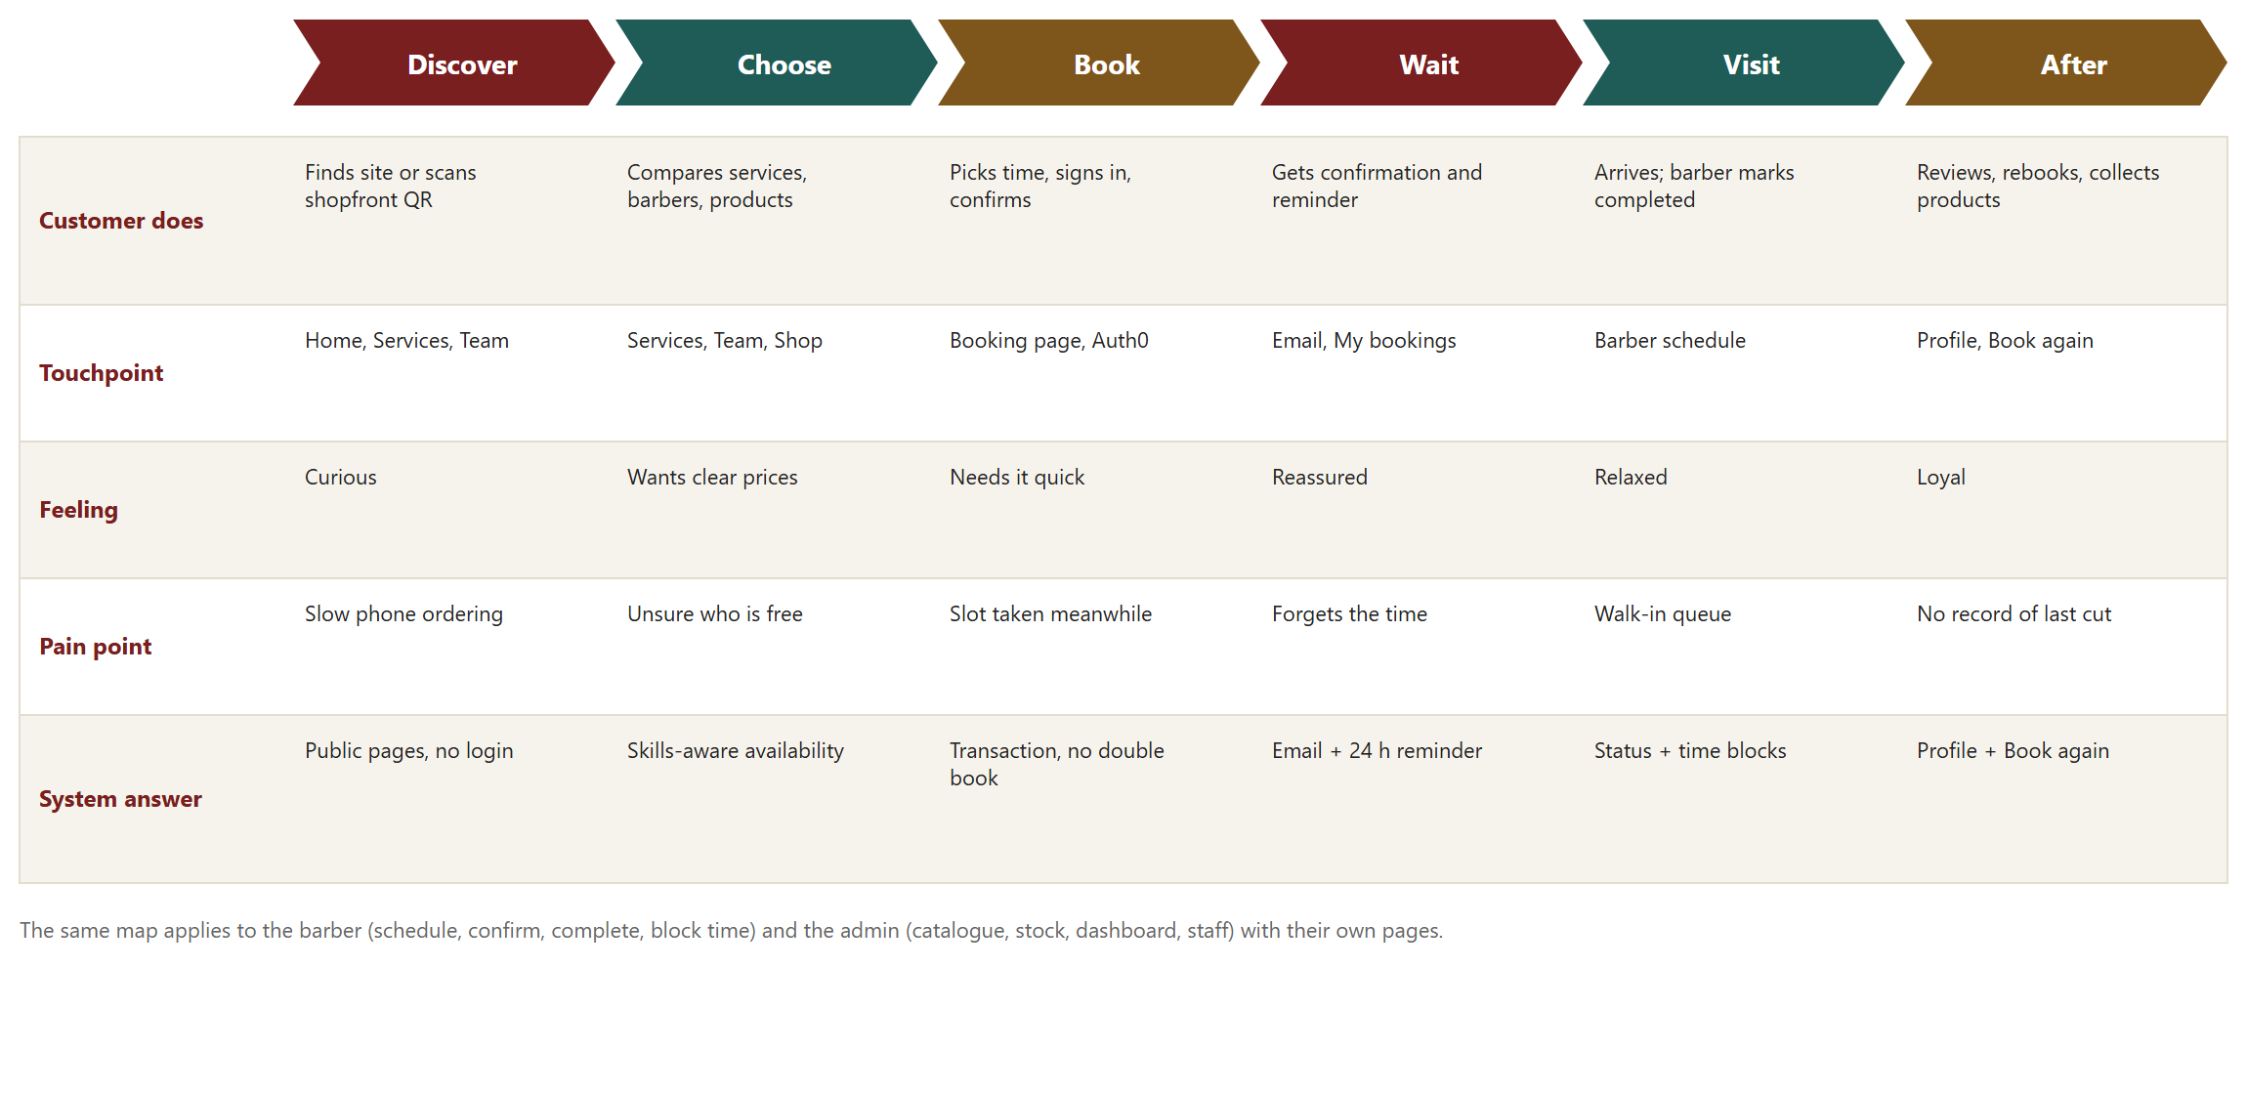
THE CUSTOMER JOURNEY
From first visit to a repeat booking.
Each stage has a pain point and a system answer: availability that respects skills, a transaction that prevents double booking, reminders, and Book again.
Kinsmen Barbershop | Emerald Solutions | Expo 2026 | 4
Notes:
Walk left to right. This is the journey map from the design document.

Slide 5
BOOK AND RESERVE
Choose, reserve, done.
Choose
Reserve
Stay informed
Pick one or more services and a barber, or any qualified barber. Only free times are shown.
Add shop products to the booking. Stock is held at once and returned if the booking is cancelled.
Booking emails and a reminder 24 hours before. Reschedule or cancel from My bookings.
Payment stays in store: no cart and no card details are held by the system.
Kinsmen Barbershop | Emerald Solutions | Expo 2026 | 5
Notes:
Greg and Zario cover this. The shop is reservation-only on purpose: online payment is on the roadmap, not in scope.

Slide 6
RUNNING THE SHOP
Tools for barbers and the owner.
Barber schedule
Catalogue and stock
Dashboard
Day and week view of their own bookings. Confirm, complete or mark a no-show. Block breaks and days off.
Edit services and prices, manage barber skills, add products and adjust stock with low-stock flags.
Bookings by outcome, revenue, top five services and low stock for any period up to a year.
Staff roles are changed in the app and every change is written to an audit log.
Kinsmen Barbershop | Emerald Solutions | Expo 2026 | 6
Notes:
Kaehil covers the dashboard and staff roles. Mention the guards: no self role change and no demoting a barber with upcoming bookings.

Slide 7
LIVE DEMO
Six minutes, six steps.
1
Open the live site
2
Book as a customer
Home, services, team and shop as a guest. (Kaehil)
Two services, any barber, reserve a product. (Greg)
3
See the email and reminder
4
Act as the barber
Open the confirmation email. (Kyra)
Confirm the booking and block an hour. (Zario)
5
Act as the admin
6
Show the proof
Edit a price, adjust stock, open the dashboard. (Kaehil)
GitHub Actions run, pull-request approvals, health endpoint. (Zario)
Fallback: the recorded walkthrough video if the Wi-Fi fails.
Kinsmen Barbershop | Emerald Solutions | Expo 2026 | 7
Notes:
Warm the site five minutes before: open both services and the health endpoint. Demo accounts: one customer, one barber, one admin. Do not show real customer data.

Slide 8
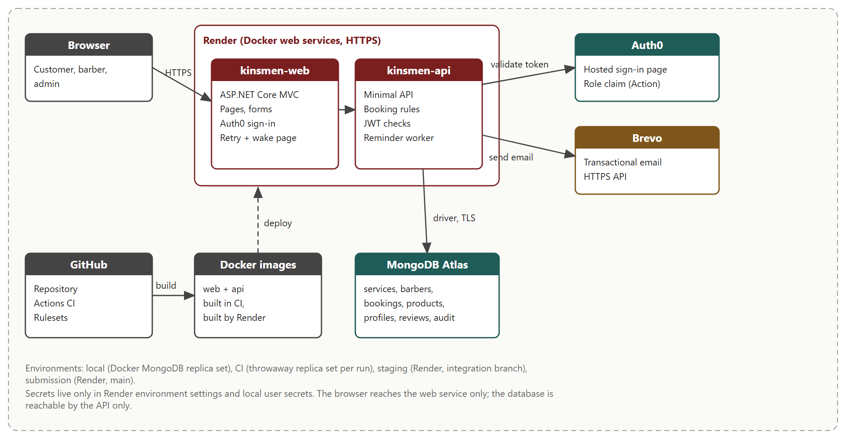
ARCHITECTURE
Two services, one database, two providers.
The browser only talks to the web app. Only the API reaches MongoDB, and secrets live in Render's environment settings.
Kinsmen Barbershop | Emerald Solutions | Expo 2026 | 8
Notes:
Zario explains the layering: pages, then service rules, then the repository. Auth0 identity, Brevo email.

Slide 9
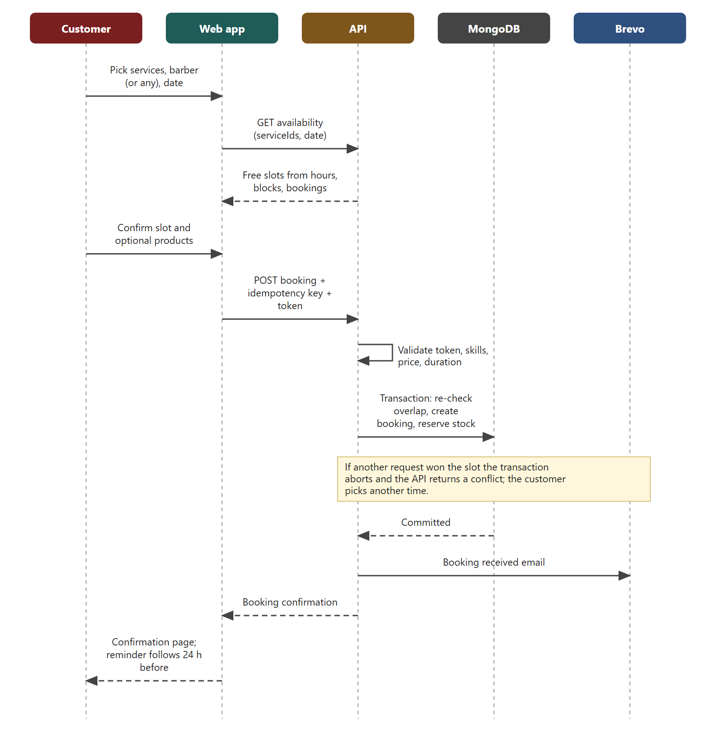
NO DOUBLE BOOKINGS
One transaction decides who gets the slot.
The API re-checks overlaps inside a MongoDB transaction, creates the booking and reserves stock. A losing request gets a clear conflict message.
Kinsmen Barbershop | Emerald Solutions | Expo 2026 | 9
Notes:
This is the key technical point. Also mention the version number and the idempotency key, which make retries safe.

Slide 10
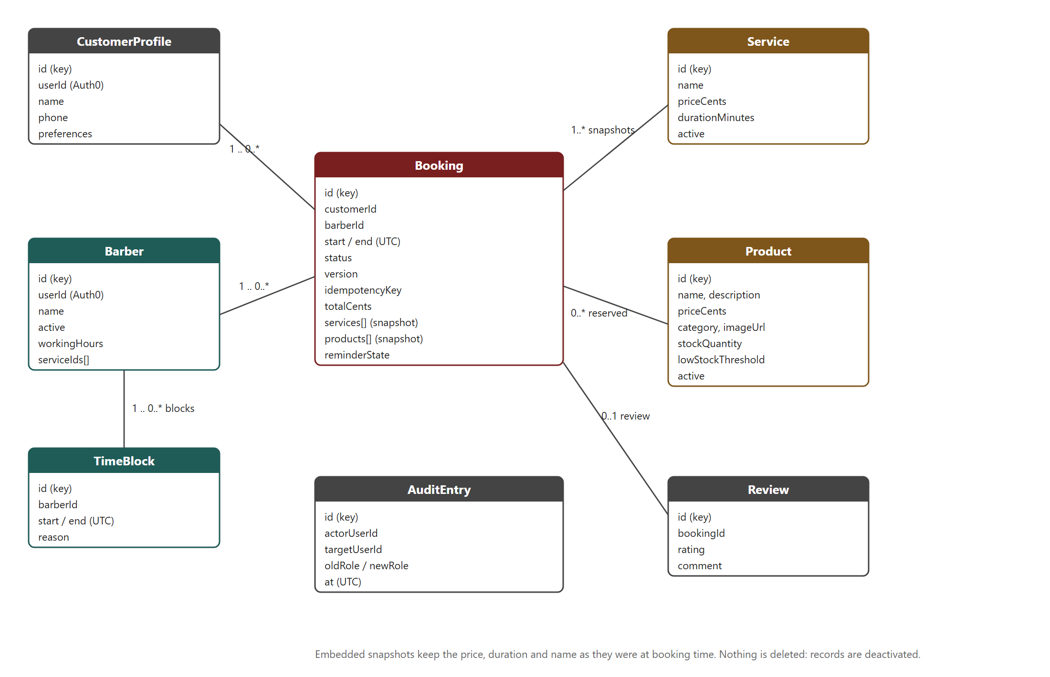
DATA MODEL
A booking keeps the facts of the day.
Services and products are copied into the booking, so later price changes cannot change history or the dashboard. Nothing is deleted, only deactivated.
Kinsmen Barbershop | Emerald Solutions | Expo 2026 | 10
Notes:
Compare with Task 1: the cart and checkout classes were removed because products are reserved, not purchased online.

Slide 11
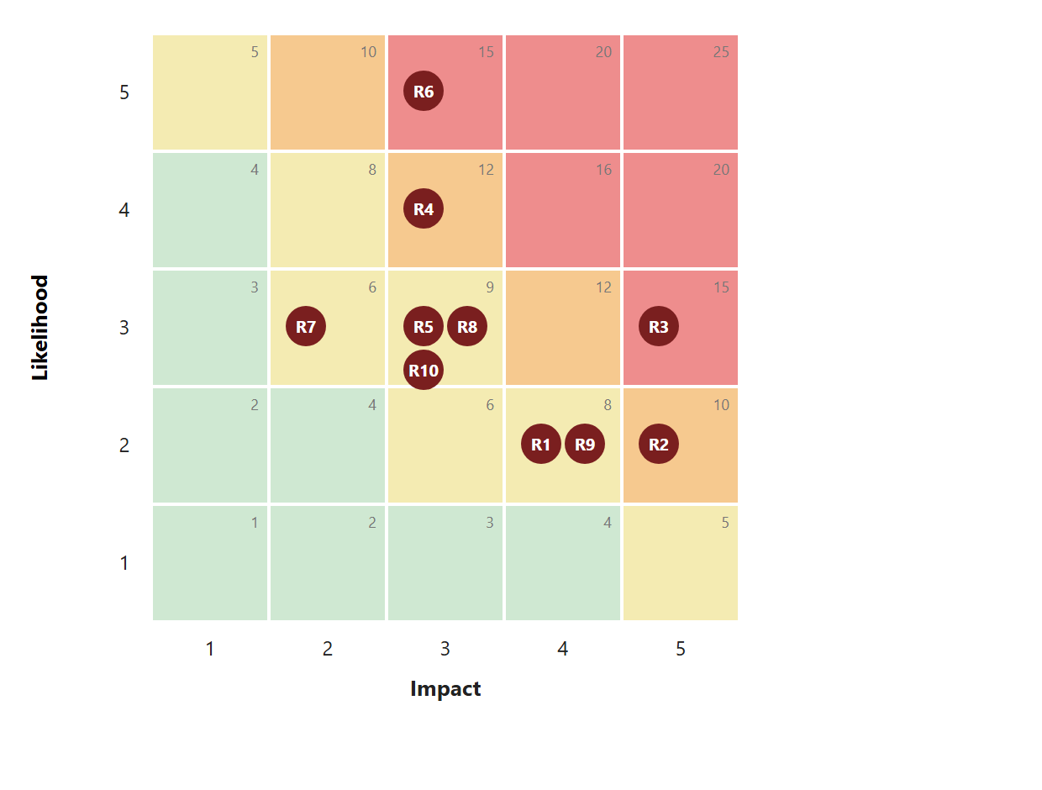
SECURITY
Ten risks rated, none above medium after controls.
Auth0 handles passwords, the API checks role and ownership on every request, secrets stay out of Git, and a Content Security Policy limits scripts.
Kinsmen Barbershop | Emerald Solutions | Expo 2026 | 11
Notes:
Kyra covers security. The heat map is the inherent risk before controls; the register in the design document shows the residual risk.

Slide 12
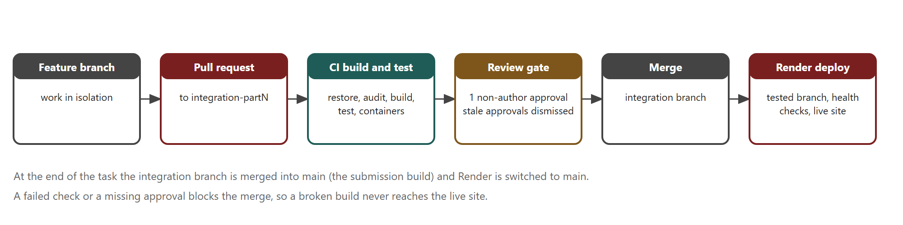
DEVOPS AND QUALITY
Nothing merges unless it passes and is reviewed.
300+ automated tests, a real MongoDB replica set in CI, container smoke tests, protected branches and one non-author approval per pull request.
300+
40+
2
automated tests
pull requests
Docker services
Kinsmen Barbershop | Emerald Solutions | Expo 2026 | 12
Notes:
Show the ruleset and one pull request with a review comment. Mention that a reviewer found three real defects in the shop PR before it merged.

Slide 13
SINCE THE LAST SUBMISSION
What Task 3 added.
Product shop
Book again
Dashboard
Reminders
Catalogue, stock and reservations inside the booking transaction.
A saved profile and a one-click rebook of a past visit.
Outcomes, revenue, top services and low stock for the owner.
24-hour reminder emails, plus a wake-up page that hides free-tier sleep.
The front end was also reworked so each feature area stands out: feature cards on the home page and accent colours per area.
Kinsmen Barbershop | Emerald Solutions | Expo 2026 | 13
Notes:
This answers the lecturer feedback on Part 2 about features blending together.

Slide 14
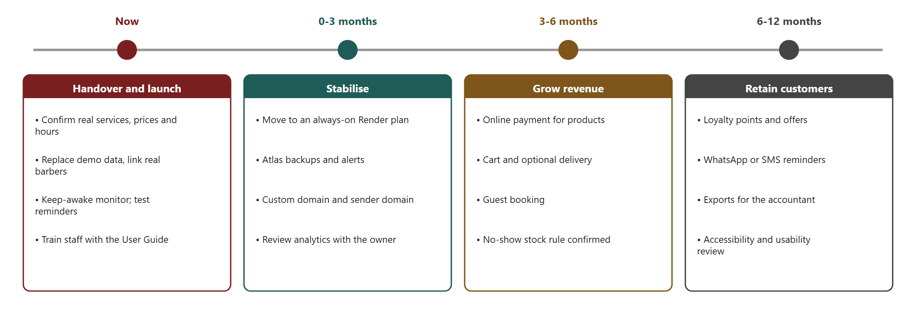
COSTS AND ROADMAP
R0 to assess, about R380 a month to go live.
Go-live moves both services to always-on plans. Costs are estimated at R16.50 per US dollar and rechecked on the day of purchase; the audience can grow to 10,000 before the plan changes much.
Kinsmen Barbershop | Emerald Solutions | Expo 2026 | 14
Notes:
Exact figures and sources are in the design document, section 10.

Slide 15
THE TEAM
Four people, one reviewed codebase.
Zario
Kaehil
Kyra
Greg
Booking API, MongoDB rules, shop reservations, technical documentation.
Release management, dashboard, deployment, CI and review process.
Authentication, security, booking emails and the reminder worker.
Customer experience, profile and Book again, interface and expo design.
Every change went through a pull request with a teammate's approval.
Kinsmen Barbershop | Emerald Solutions | Expo 2026 | 15
Notes:
Each person says one sentence about their part. Evidence is in the GitHub history.

Slide 16
QUESTIONS WE EXPECT
Who answers what.
Question
Answers
Short answer
How do you stop two people booking the same slot?
Zario
Transaction, overlap re-check, version and idempotency key.
How is a user's identity protected?
Kyra
Auth0, signed tokens, role and ownership checks.
What happens if the site is asleep?
Kaehil
Retry handler, wake page, always-on plan at go-live.
Why MongoDB and not SQL?
Zario
Booking snapshots, transactions, free tier, official .NET driver.
What would you build next?
Greg
Online payment, loyalty, WhatsApp if the client approves.
How do you know it works?
Kaehil
300+ tests, CI on every pull request, review gate.
Kinsmen Barbershop | Emerald Solutions | Expo 2026 | 16
Notes:
Rehearse these answers. If asked something outside your area, hand over to the owner.

Slide 17
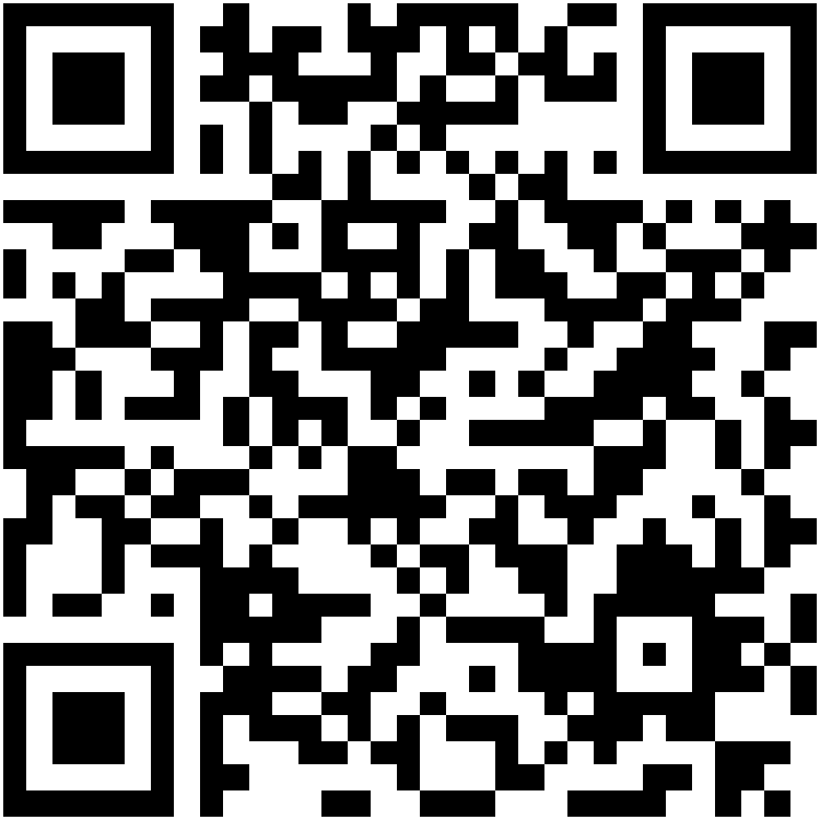
THANK YOU
Try it yourself.
Live app
Documentation and code
Kinsmen Barbershop, Shop 5, 8 Mackeurtan Ave, Durban North
Emerald Solutions: Zario Di Paolo, Kaehil Indurjeeth, Kyra Naidoo, Gregory Luyckfasseel
Notes:
Invite visitors to scan, make a test booking and tell us what they think. Collect feedback on paper.

